Slide 1

21AS64D2
Vibration Engineering
Unit - 5
Multi Degree of Freedom System
Numerical methods

Slide 2

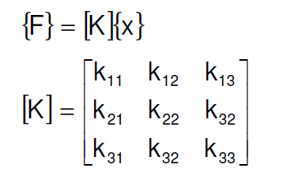

Influence coefficients
Influence coefficients are defined as the influence of unit displacement at one point on the forces at various points of a multi-DOF system.
OR
It is the influence of unit Force at one point on the displacements at various points of a multi-DOF system.
For a multi degree of freedom system , the equations of motions are written in influence coefficients

Slide 3




Influence coefficients
Mass/ inertia matrix stiffness influence coefficients
Matrix of flexibility influence coefficients
Matrix of flexibility mass/inertia coefficients

Slide 4
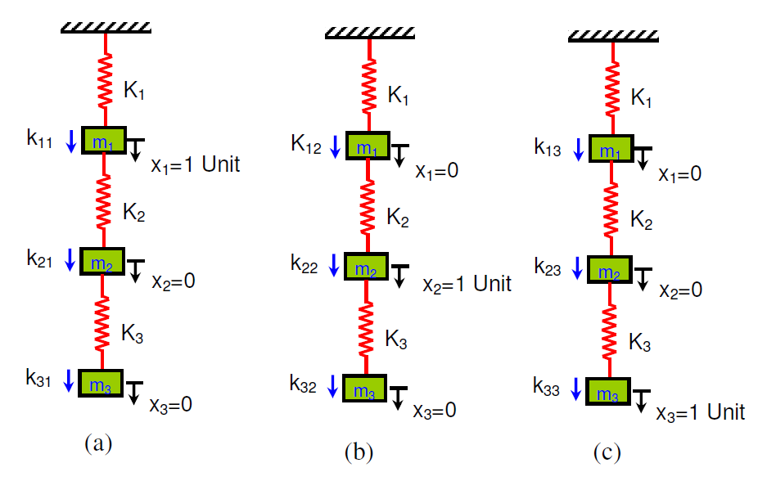
Influence coefficients
Example - 1

Slide 5
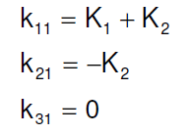
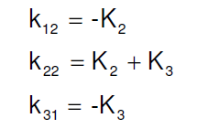
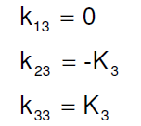
Influence coefficients
Example - 1 Obtain the stiffness coefficients of the system
Step 01 - apply unit deflection x1 = 1 (x2 =0, x3=0) at m1.
The force equilibrium equations are
similarly , apply unit deflection at m2 (x1=0, x2=1, x3=0) and m3 (x1=0. x2=0, x3=1), the equations are

Slide 6
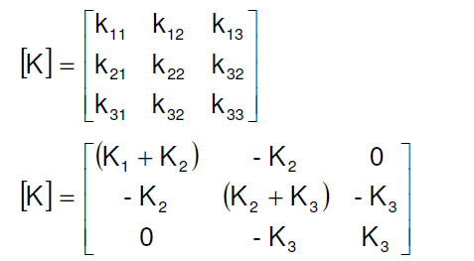
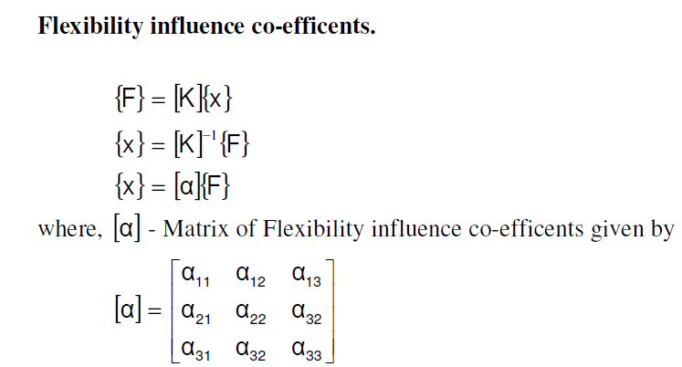
Influence coefficients
The influence stiffness matrix is given by
The flexibility influence matrix is given by

Slide 7
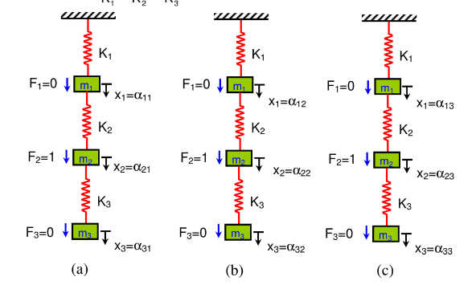
Influence coefficients
Example - 2

Slide 8
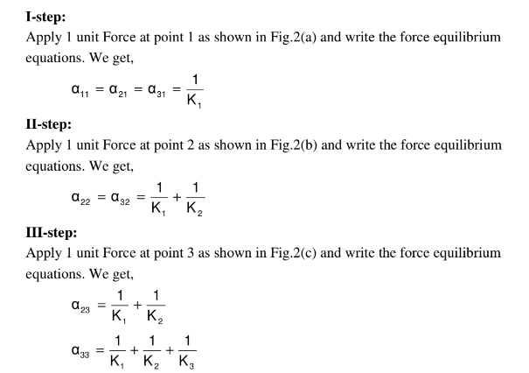
Influence coefficients
Example - 2 Writing the force equations and finding elements of flexibility influence matrix

Slide 9
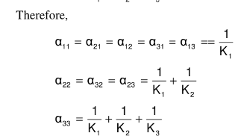
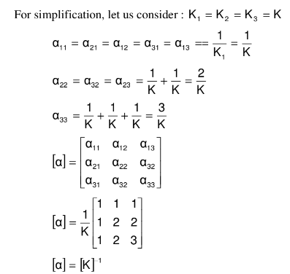
Influence coefficients
Example - 2 Writing flexibility influence matrix

Slide 10



Matrix Iteration Method
Using this method one can obtain natural frequencies and modal vectors of a vibratory system having multi-degree freedom
Its required to have w1<w2<w3<.....<wn
Equations of motion of a vibratory system having n DOF in matrix form is written as:
(eq1)
(eq2)
Substituting eq2 in eq1 we get

Slide 11
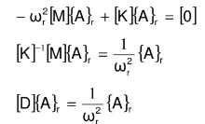

Matrix Iteration Method
For principal modes of oscillations, for rth mode,
eq3
Where [D] is Dynamic matrix
Eq3 converges first natural frequency and first modal vector
Where [D1] is inverse dynamic matrix

Slide 12
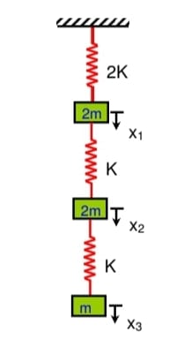


Matrix Iteration Method
Q1) Find first natural frequency and modal vector of the system shown in the Fig using matrix iteration method. Use flexibility influence co-efficients.
Using influence coefficients find the stiffness matrix
First natural frequency and modal vector

Slide 13

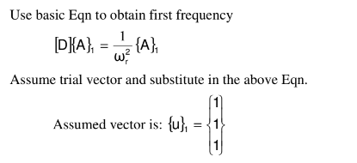
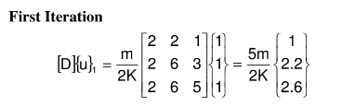
Matrix Iteration Method
Obtain Dynamic Matrix [D] = [K]^-1 [M]
To find first frequency

Slide 14
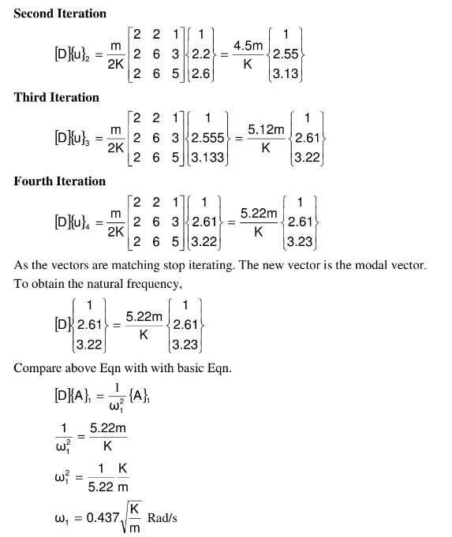
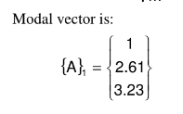

Slide 15
Maxwell’s Reciprocation Theorem
Definition:
Maxwell's Reciprocal Theorem is a fundamental principle in structural mechanics which states that in a linearly elastic structure, the displacement at a point D due to a unit force applied at a point C is equal to the displacement at point C when the same unit force is applied at point D.
Mathematical Statement:
Consider two points, C and D, on an elastic structure. Let δ_{DC} represent the displacement at point C when a force F_{C}​ is applied at point D. Similarly, let δ_{CD}​ represent the displacement at point D when the same force F_{D}=F_{C} is applied at point C. Maxwell's Reciprocal Theorem can be mathematically expressed as:
δ_{DC} = δ_{CD}
Assumptions:
Linear Elasticity: The material follows Hooke's Law, where stress is directly proportional to strain.
Small Displacements: The displacements caused by the forces are infinitesimally small.
Static Loading: The forces are applied statically, meaning there are no dynamic effects such as inertia or damping.

Slide 16
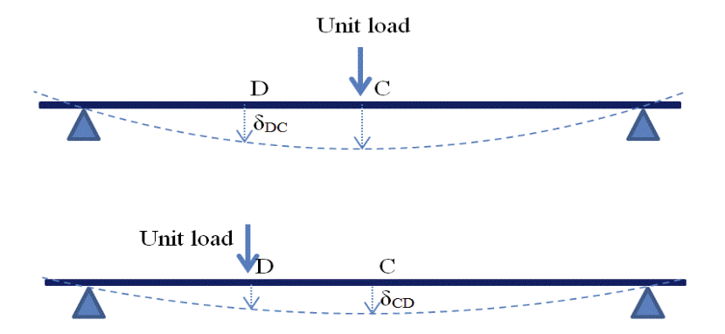
Derivation of the theorem
When a unit load is applied at point C on the beam, the work done against the elastic forces on the beam is ½ δ_{CC}
If we then apply an additional unit load at point D, the extra work done is
½( δ_{DD} + δ_{CD})
Now, let's consider applying the forces in the reverse order. First, if the unit load is applied at point D, the work done is ½ δ_{DD}
Then, if we add the load at point C, the additional work done is
½ (δ_{CC} + δ_{DC})
Since the total work done in both scenarios must be the same, we can equate the two expressions:
½ δ_{CC} + ½( δ_{DD} + δ_{CD} )= ½ δ_{DD} + ½( δ_{CC} + δ_{DC})
This equation simplifies to show that
δ_{CD} = δ_{DC}
which is Maxwell’s Reciprocal Theorem.
To better understand Maxwell’s reciprocal theorem, consider a beam subjected to a point load, as shown in the figure.

Slide 17
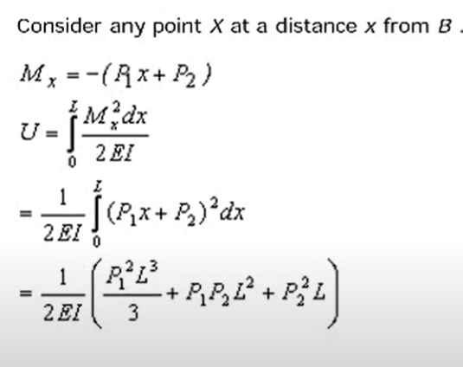
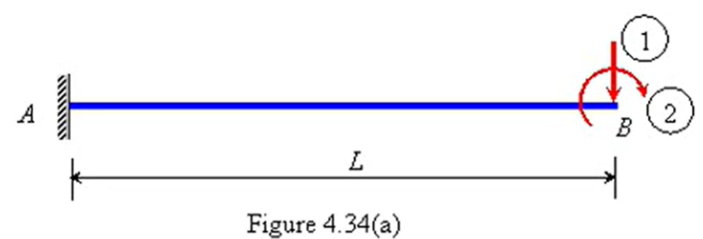
Example Problem
Verify Maxwell-Betti law of reciprocal displacement for the cantilever beam shown in Figure 4.34(a).
Solution: Apply the forces P1 and P2 in the directions 1 and 2, respectively. The total strain energy stored is calculated below.

Slide 18
Limitations and Applications
Limitations of Maxwell's Reciprocal Theorem
Non-linearity:
The theorem is only valid for linear elastic materials. In cases where the material exhibits nonlinear behavior (e.g., plastic deformation), the theorem does not hold.
Large Deformations:
For large displacements or rotations, the linearity assumption breaks down, and Maxwell's Reciprocal Theorem may not be applicable.
Anisotropy and Temperature Effects:
The theorem assumes isotropic materials, meaning the material properties are the same in all directions. For anisotropic materials (like composites) or in cases where temperature significantly affects material properties, the theorem may not apply.
Applications in Vibrations Engineering
In Vibrational Analysis:
Maxwell's Reciprocal Theorem simplifies the analysis of vibrational systems by allowing engineers to compute displacements and forces without recalculating for every new force location.
It is particularly useful in modal analysis, where the dynamic response of a structure is studied by breaking down complex vibrations into simpler modes.
In Structural Engineering:
The theorem is used in the design and analysis of structures like bridges, buildings, and mechanical components. It helps in verifying numerical solutions obtained from finite element analysis (FEA) by ensuring the reciprocity of calculated displacements.

Slide 19
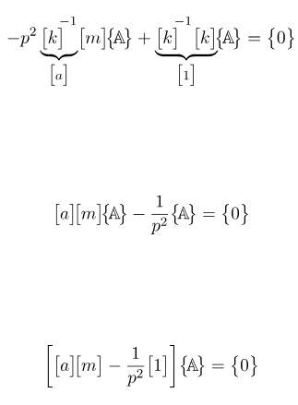


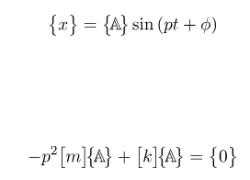
Dunkerley Method
Dunkerley’s Formula is another method of estimating the lowest (fundamental) natural frequency of a system without having to solve an eigenvalue problem. Rather than using the stiffness matrix, Dunkerley’s Method makes use of the flexibility matrix which is the inverse of the stiffness matrix.
Starting with the equations of motion for a general degree of freedom system
and assuming simple simultaneous harmonic motion of the form
Premultiplication by k-1 results in
for a non-trivial solution to exist it is required that

Slide 20
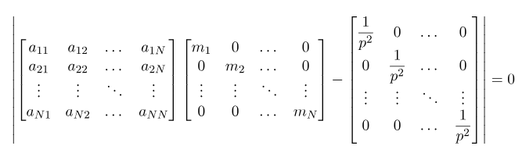







Dunkerley Method
ignoring all but the first term on the LHS of results in
known as Dunkerley’s Formula and provides an estimate of the fundamental natural frequency of a system.
Due to the terms that have been neglected, the natural frequency obtained using Equation will be lower than the actual fundamental natural frequency. Dunkerley’s Formula therefore provides a lower bound on the lowest natural frequency of the system
Let the roots of be given by
we note that for many systems the higher natural frequencies are significantly larger than the fundamental natural frequency so that

Slide 21
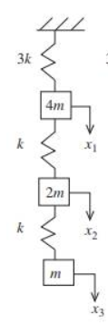
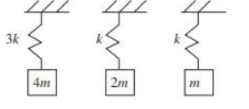
Dunkerley Method - Example 1
Use Dunkerley’s formula to find the lowest natural frequency
of the system shown.
Given:
m₁= 4m; m₂= 2m; m₃=m
k₁= 3k; k₂= k; k₃=k
Taking individual components

Slide 22
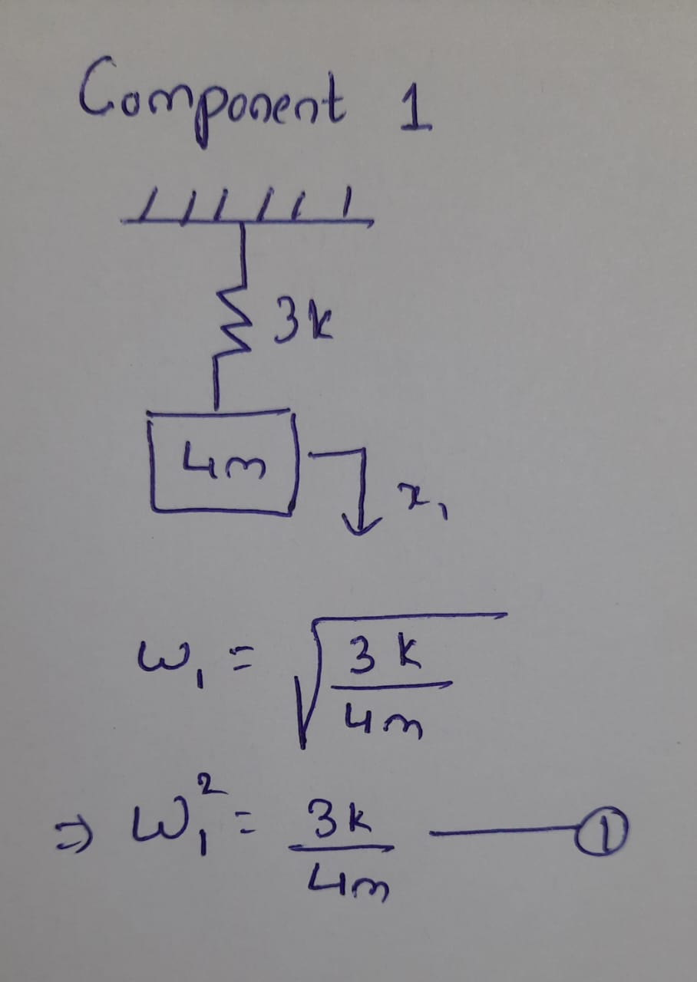
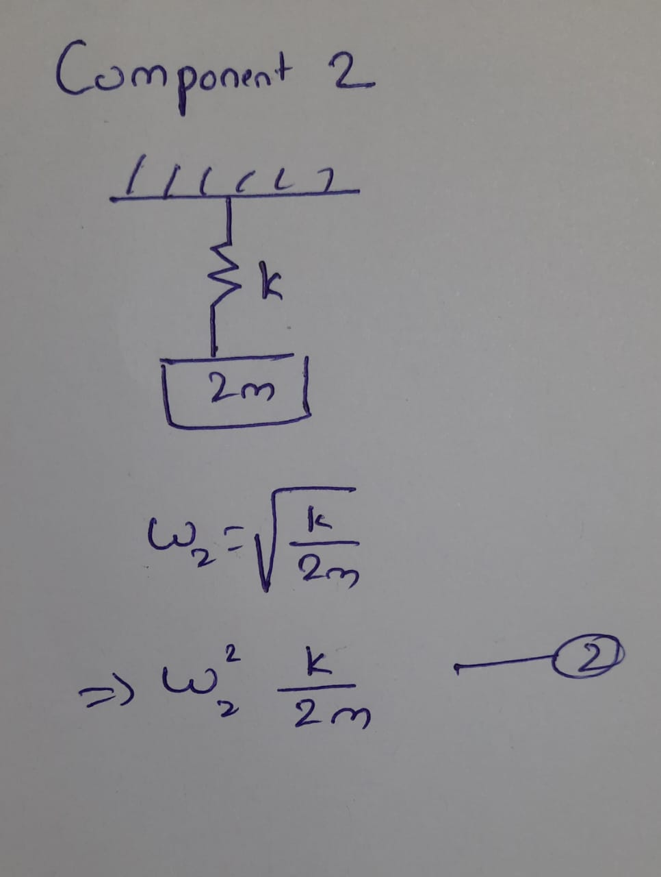
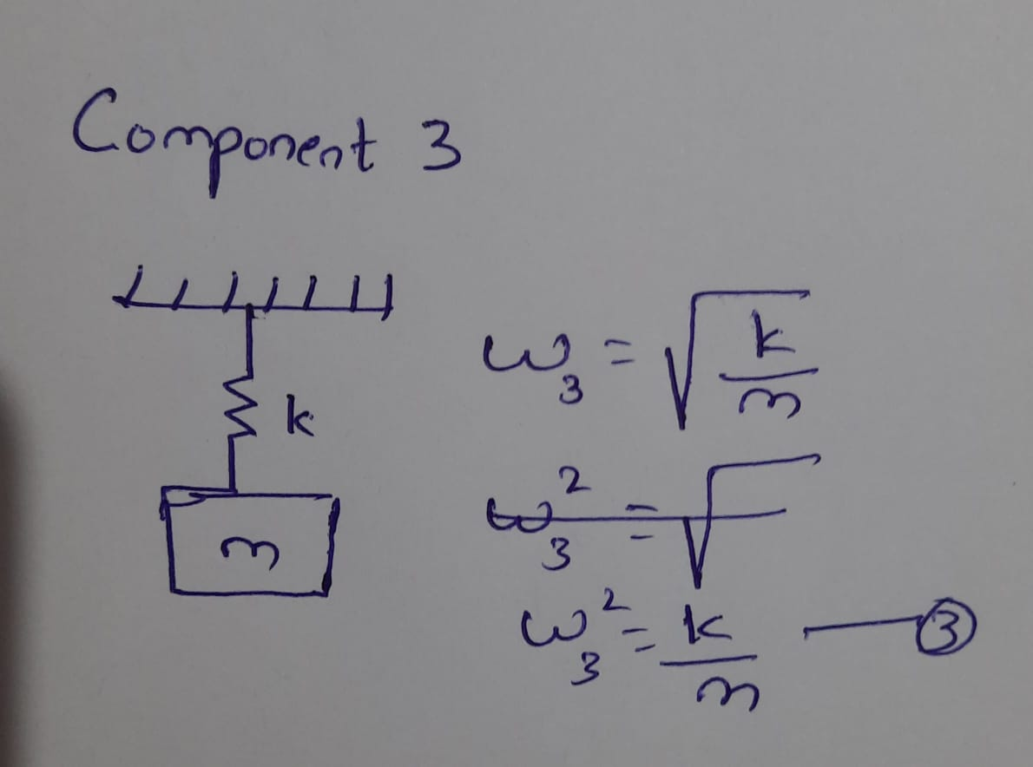
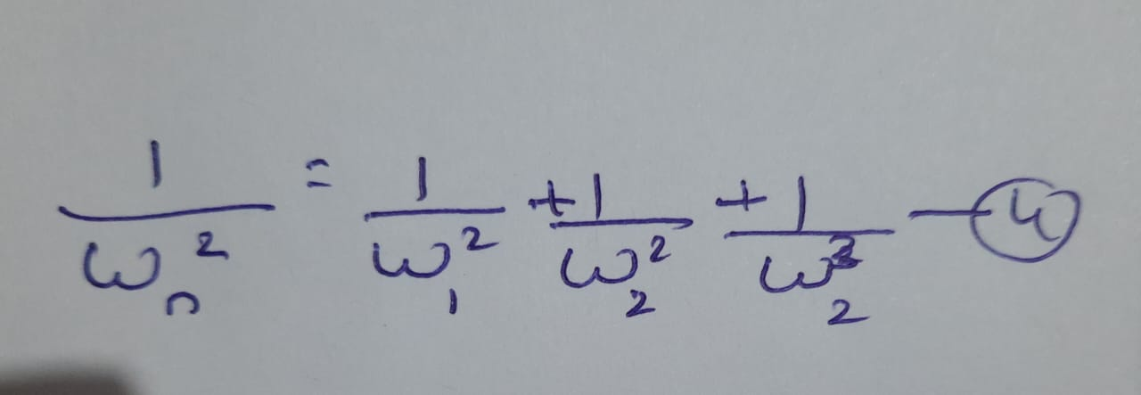
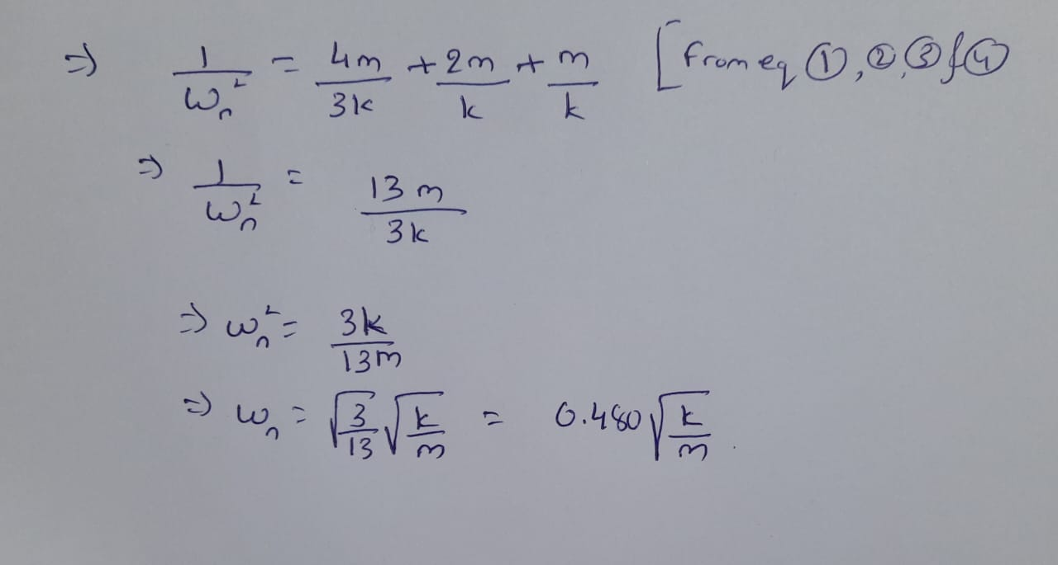
Dunkerley Method - Example 1

Slide 23
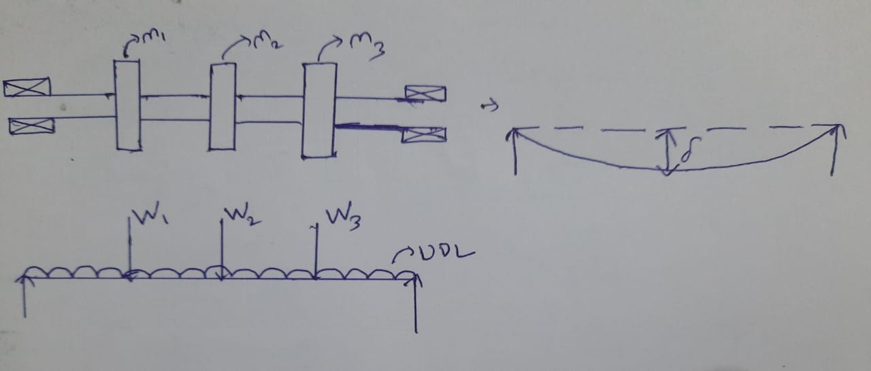
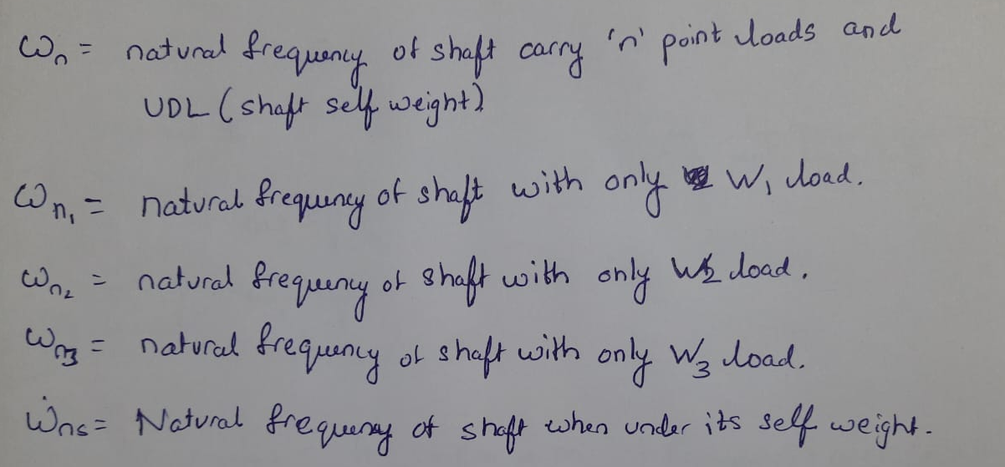
Dunkerley Method - Estimating Critical Speed of Shaft
The speed at which shaft has maximum deflection is called as shaft critical speed.

Slide 24
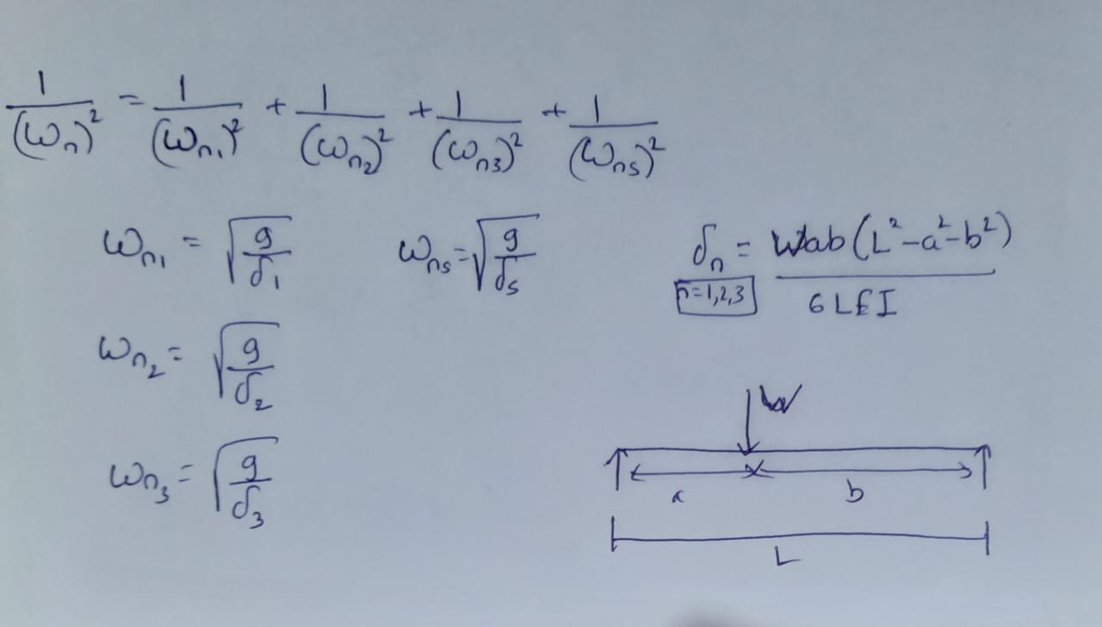
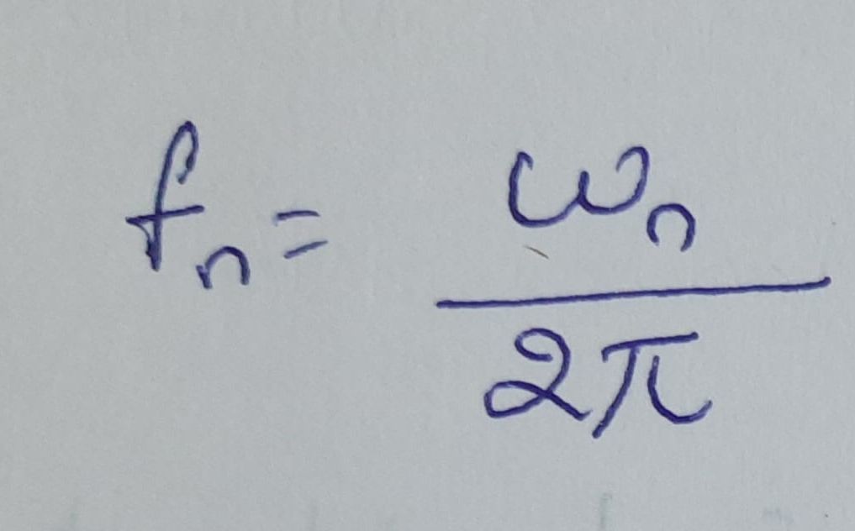
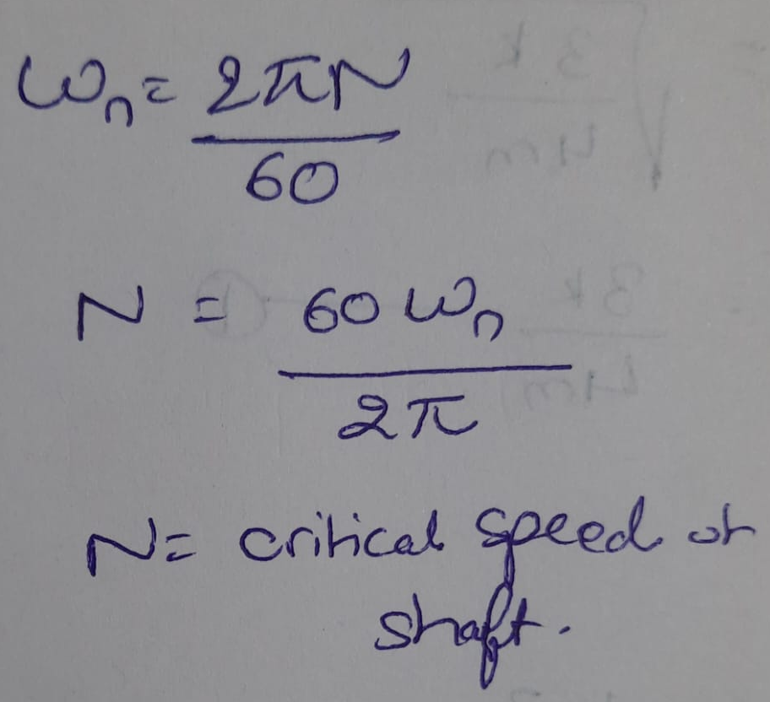
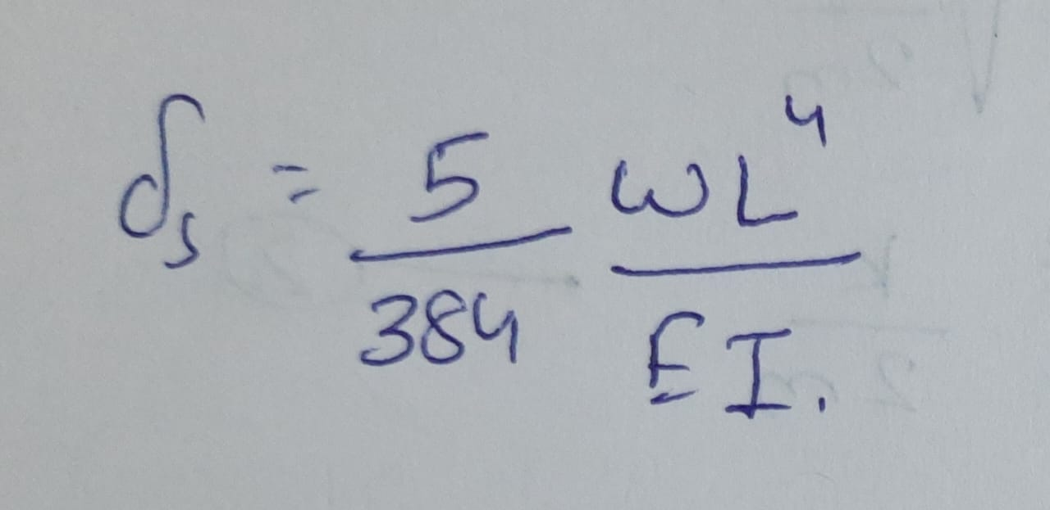
Dunkerley Method - Estimating Critical Speed of Shaft

Slide 25
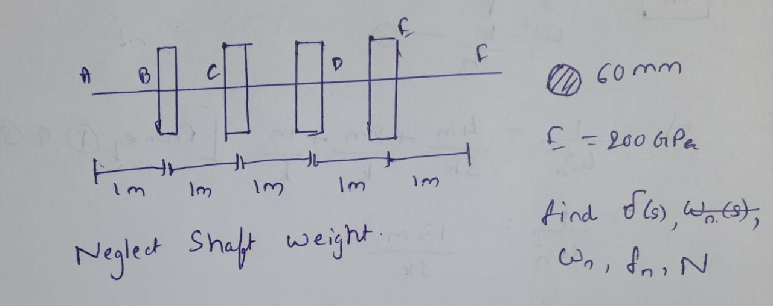
Dunkerley Method - Critical Speed of Shaft Example
Take each rotor mass is 50 kg.

Slide 26
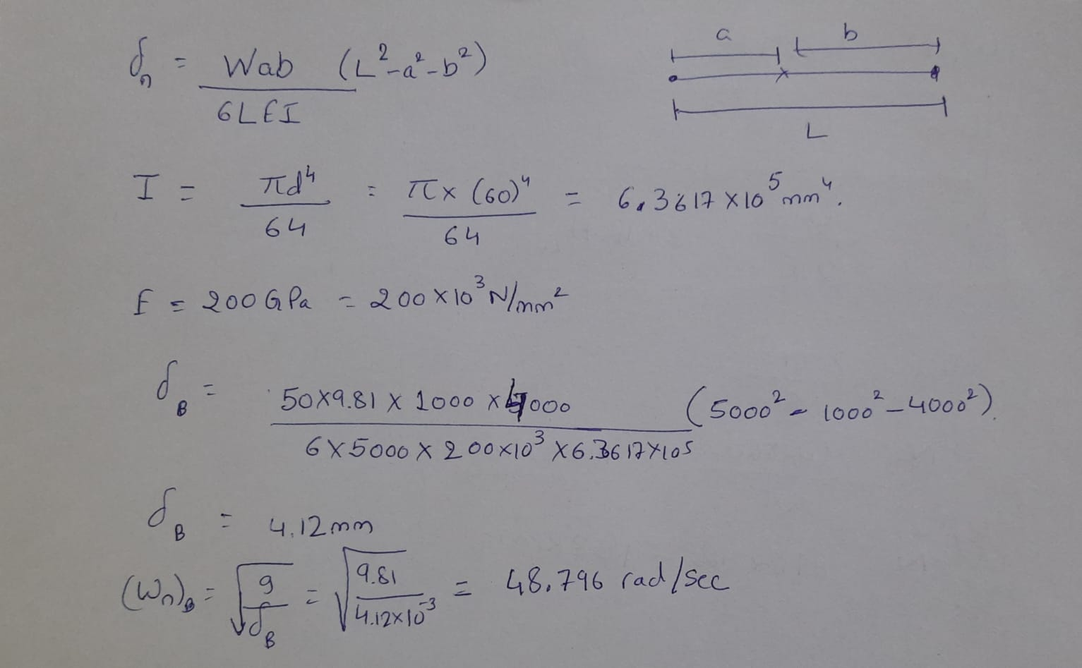
Solution

Slide 27
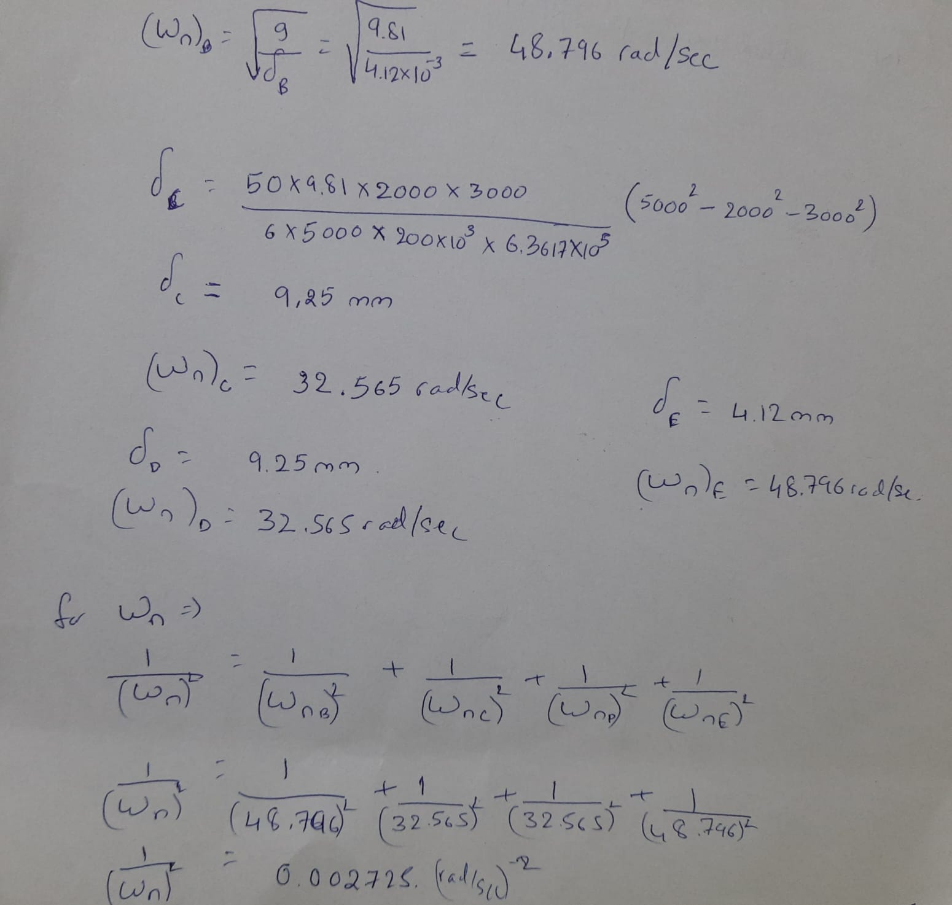
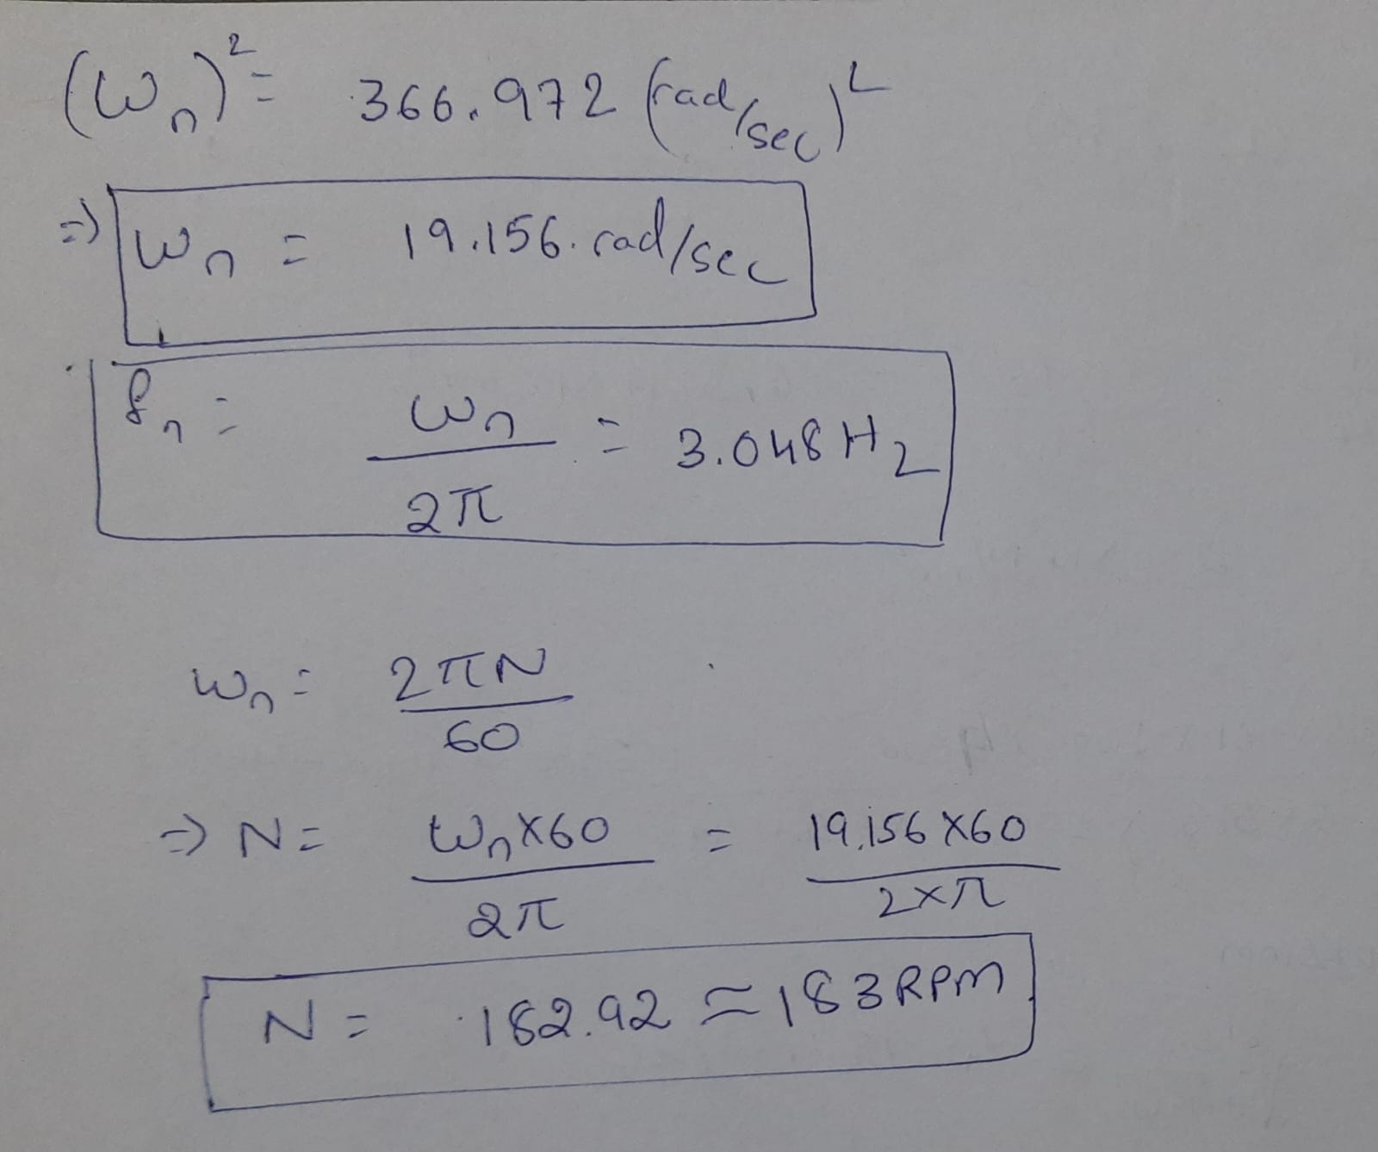
Solution

